Slide 1
SQL Relational Database Demonstration – UK Road Accident Data
Student: Anthony Eddei Kwofie
Programme
MSc Artificial Intelligence and Data Science – University of Hull (London Campus)
Dataset: accident_data_v1.0.0_2023.db
Scenario: Acting as a government data scientist building a secure SQL database for accident data.

Slide 2
Managing Data Responsibly
Technical | Ethical | Legal
Data integrity & security | Protecting individual privacy | GDPR (2018) compliance
Avoiding redundancy | Fair and unbiased data use | Lawful access & retention
Access control & audit trails | Responsible reporting | Data minimization

Slide 3
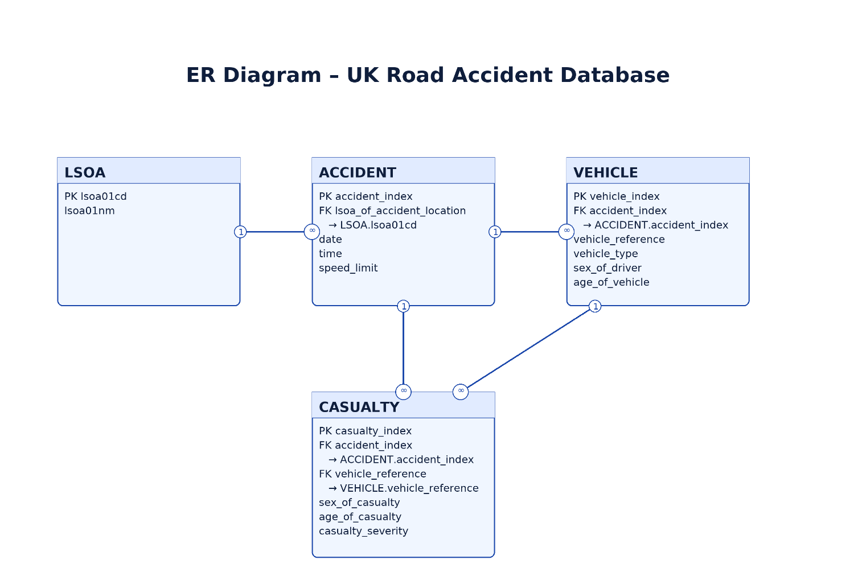
Entity–Relationship Model of the Accident Database
Diagram of tables and relationships (simplified version below)
Primary Keys (PK) and Foreign Keys (FK) clearly labelled

Slide 4
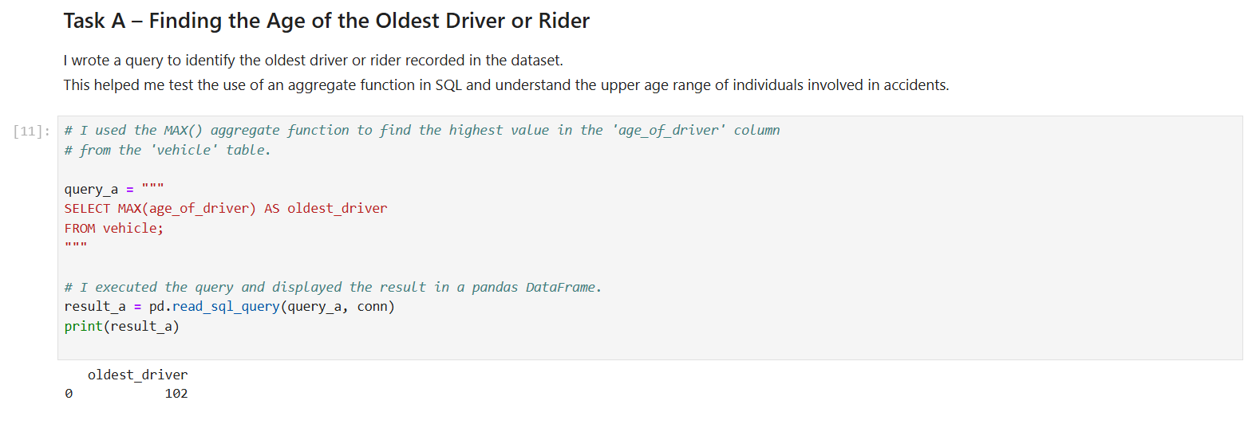
Finding the Oldest Driver or Rider
Show query and output
Explain use of aggregate function

Slide 5
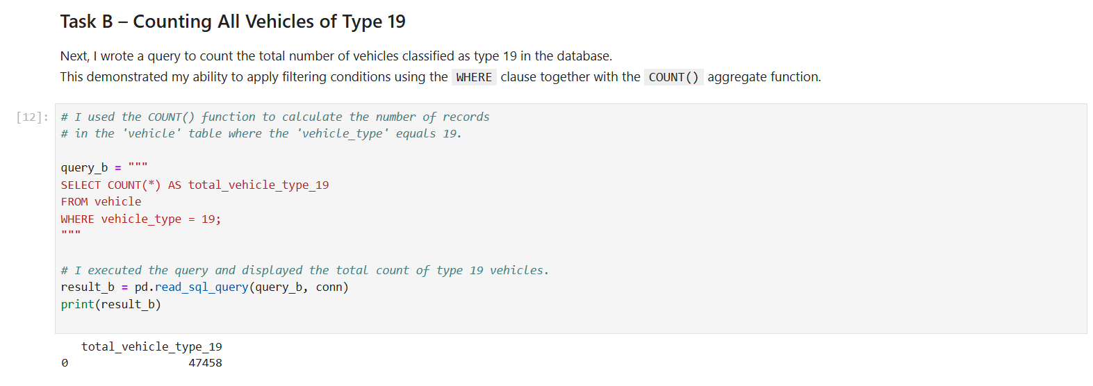
Counting Vehicles of Type 19
Show total count result
Explain filtering with WHERE

Slide 6
Joining Tables to Retrieve Local Accident Details
Explain use of multiple joins
List displayed fields:
Sex of driver
Sex of casualty
Speed limit
Age of vehicle
Region name

Slide 7

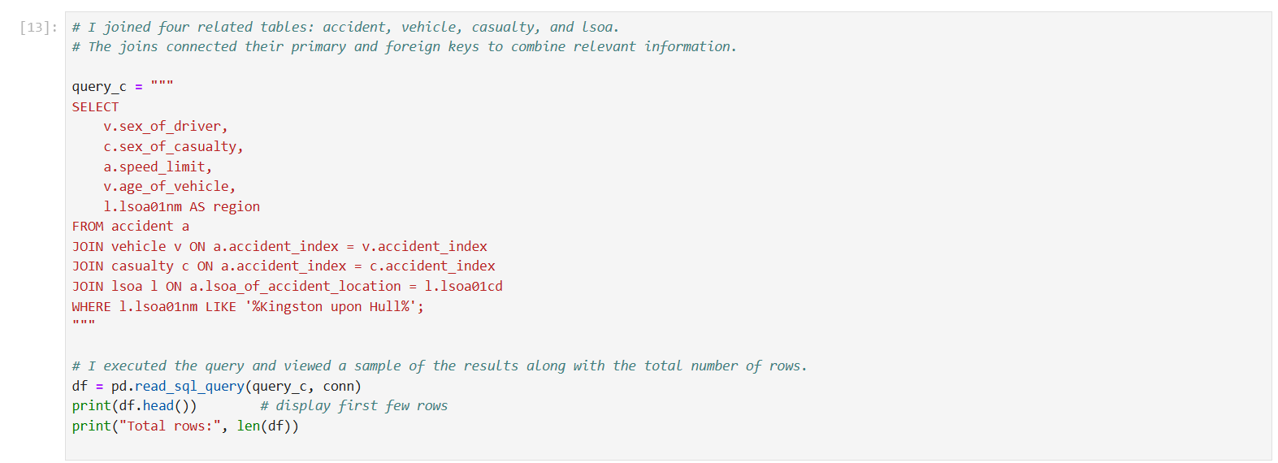
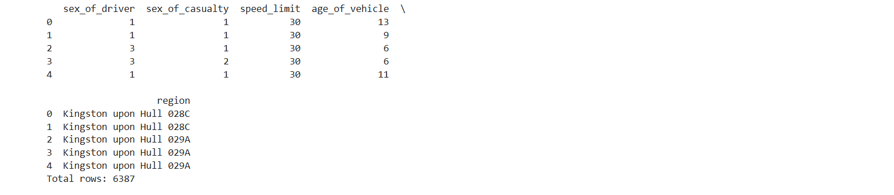

Slide 8
Summary of Findings and Good Practice
SQL enabled structured and secure data access.
Relational design reduced redundancy and improved data integrity.
Queries provided actionable insights for public safety.
Ethical and legal principles guided the data management process.

